Slide 1
(420-1N6-AB) Technical Support
Fall 2023

Slide 2
The Teachers

Slide 3
Youmna Badawy (Section 2)
Office:
Penfield P235
Office Hours:
Mon: 3-4 PM, TUE: 10 AM – 12 PM, WED: 1-4 PM
Other hours: By appointment on Outlook: Booking Link
Contact:
MIO (I check every day)
Teams (I check every day)
Course Website:
Léa

Slide 4
Tell me more about you
What's your name?
What high school are you from?
Why did you choose computer science?
One fun fact about you? (Example: I play the guitar and once got to perform in front of a large crowd)

Slide 5





What this course includes?
Computer Hardware
Operating systems
Intro to Networking
Binary System
Intro to Server Hardware
Helpdesk and Troubleshooting computers
Notes:
•Each topic above is a massive field of research and industry in its own right -- you could get a PhD in each! We will be introduced to each briefly, and at a high level (overview) to come away with a better technical understanding than we had before.

Slide 6
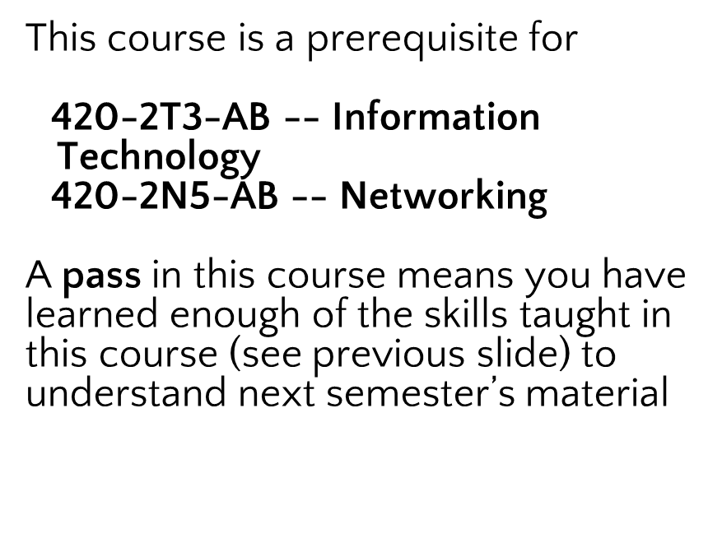
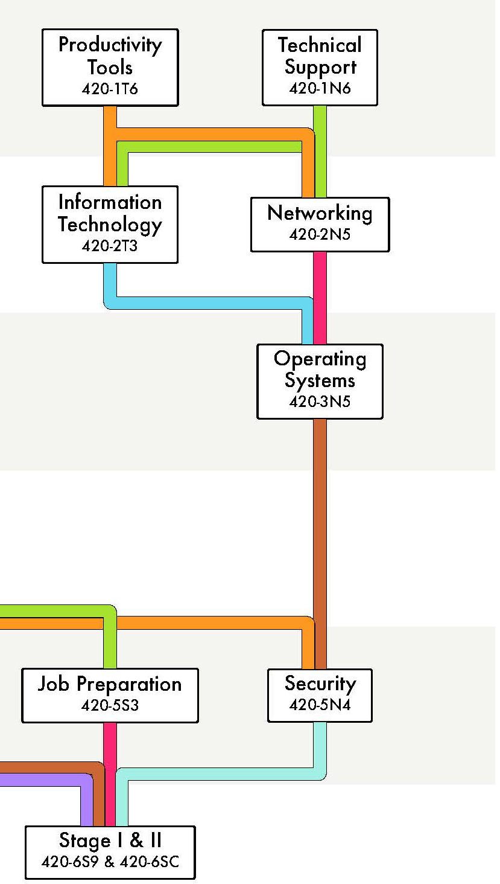
What is this course preparing you for?

Slide 7



What will I learn?
Learn to troubleshoot hardware, firmware and software.
Understand computers from binary to the use of each hardware part
Understand the role of IT Helpdesk Technicians
Perhaps even build your own PC!

Slide 8
Workload
2 Hours lecture
4 Hours laboratory
3 hours homework

Slide 9

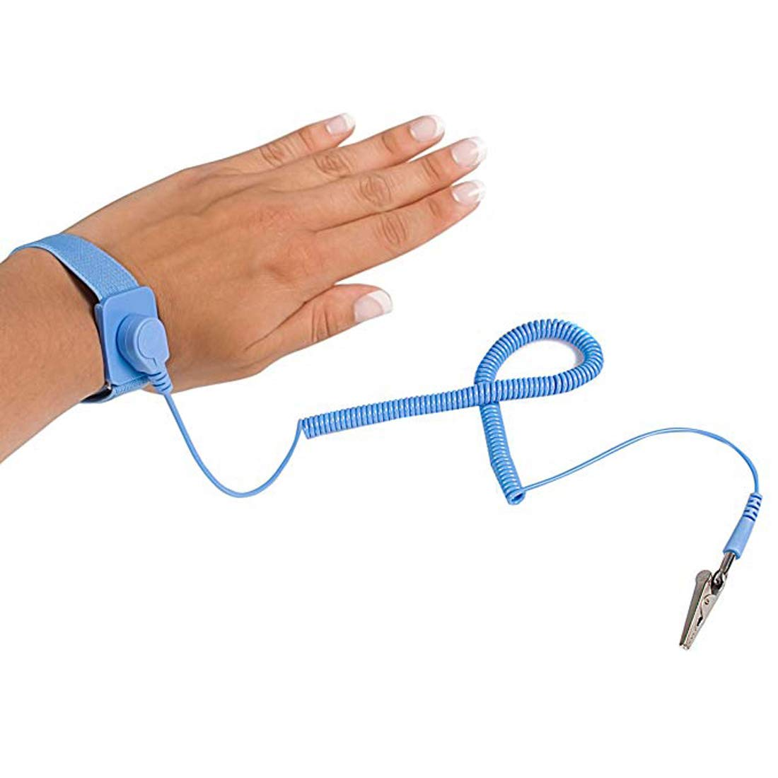
Material to acquire
No textbooks!
Multiheaded Screwdriver x 1:
For assembling computers!
Example: Picquic-88001-Multi-Bit-Screwdriver-Full-Size
(Optional but recommended) Anti-static ESD bracelet band:
For your safety when playing with electronics
Example: Antistatic-Wrist-Strap
USB 3.0 Stick with at least 16Gb.
Example: USB 3.0 16Gb Sticks

Slide 10
Classroom Policies & Student Success
Notes:
Lecture notes go here

Slide 11
How to excel in this course?
Test 1: 20% (Week 7-8)
Test 2: 20% (Week 14-15)
Assignments and Labs (60%)
4 assignements (15% each) – every 2-3 weeks
5 or more Labs will be done, your attendance is mandatory!

Slide 12
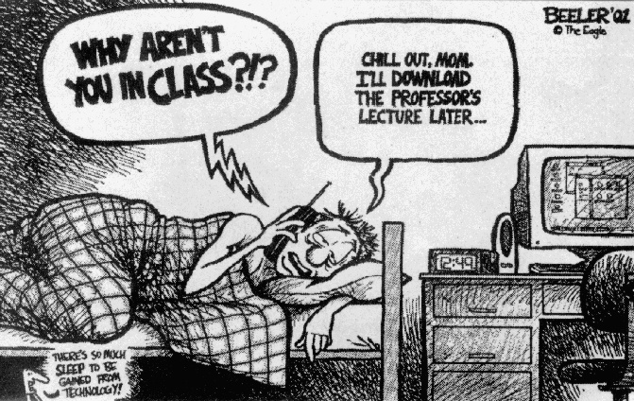
Rule 1: Attend all classes and labs!
I will freely provide my slides and as many course resources as necessary to supplement this class.
But! My course notes are not a substitute for regular class attendance. Hands on experience is key!

Slide 13
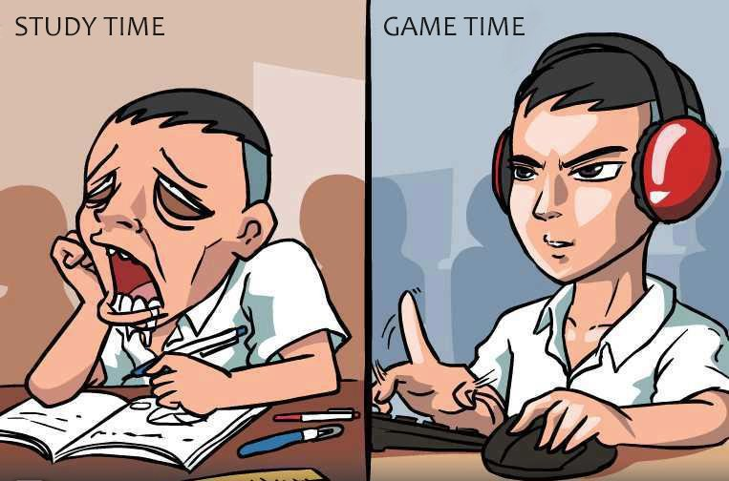
Rule 2: Consult the Support Material
Class Slides (available on Léa)
Lab and exercises in class
Assignments
Your class notes
Other:
Handouts
Suggested reading material
Suggested textbooks

Slide 14
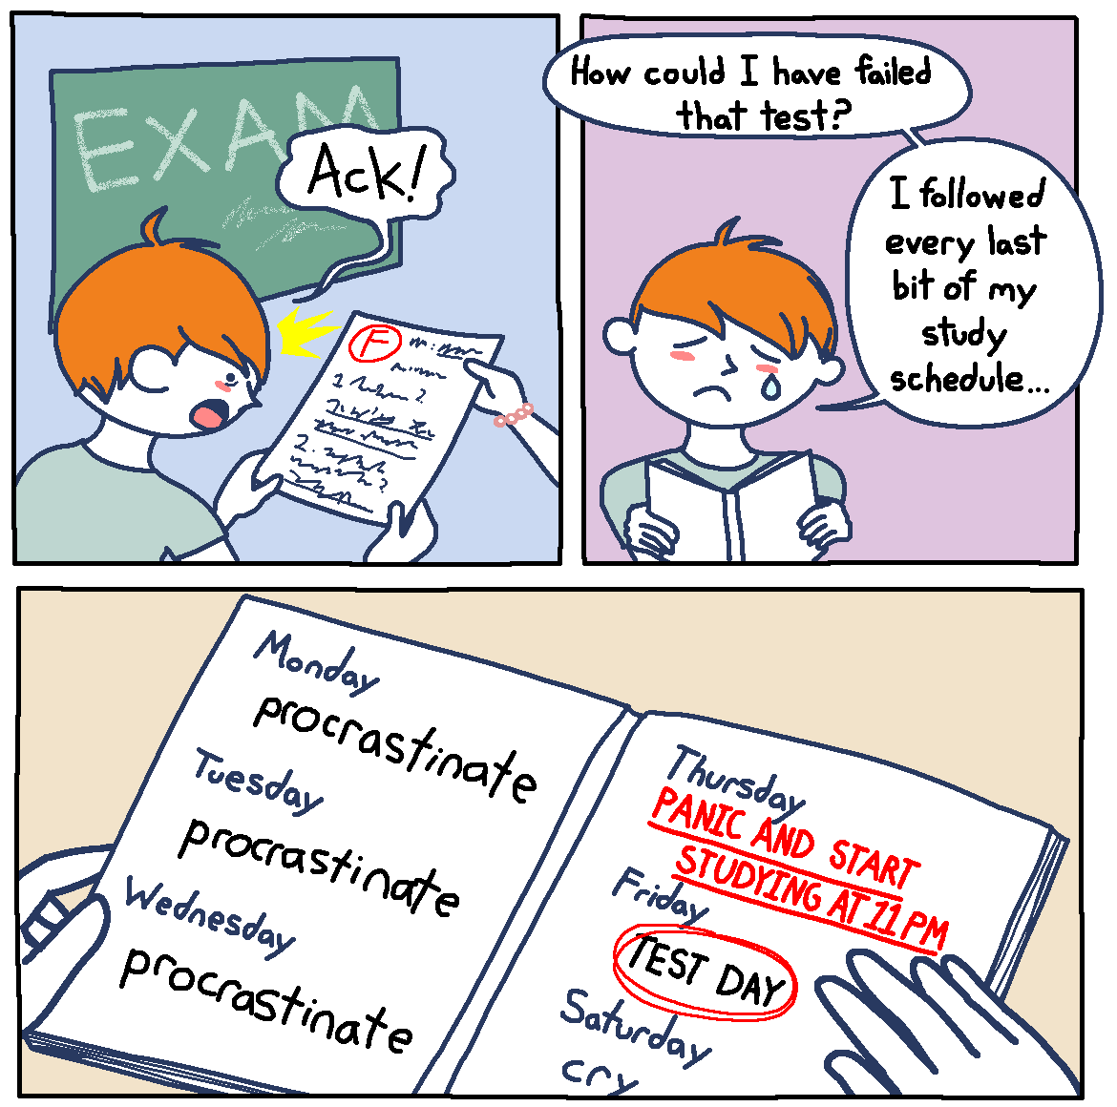
Rule 3: Use a calendar to track all your deadlines
To stay on track for all your deadlines, try to plan one or two weeks ahead!
Complete your assignments on time
But! Endeavour to at least hand in assignments. Better late/incomplete than never.
If you miss a deadline, please don't ignore it!
MIO me. I’m here to help! And that includes for late/incomplete assignments.

Slide 15

Rule 4: Reach out for help!
Reach out to me if you ever feel stuck or overwhelmed
Try your best to get to know other students!
Help each other out! You will learn much more from working through the assignments yourself and from teaching eachother than you will from listening to me
And, building relationships with new peers is, in my opinion, the best part of school
Seek out help if you are struggling (from me, from peers, from John Abbott student services, etc.)

Slide 16

Rule 5: Be curious!
This field has a lot of support online, videos and more!
Stay curious, the Internet is your Oyster!

Slide 17

Feedback
Let me know how things are going in the course:
Am I covering the material too slowly or too quickly?
Are the slides material clear?
Can you read my handwriting?
Can you hear me well?
Does my answer make sense?
Do you understand the assignment questions?
Etc.

